Slide 1

Project Name: EduPredi
Developed by: Meaad Farag Bayuosef:

Slide 2

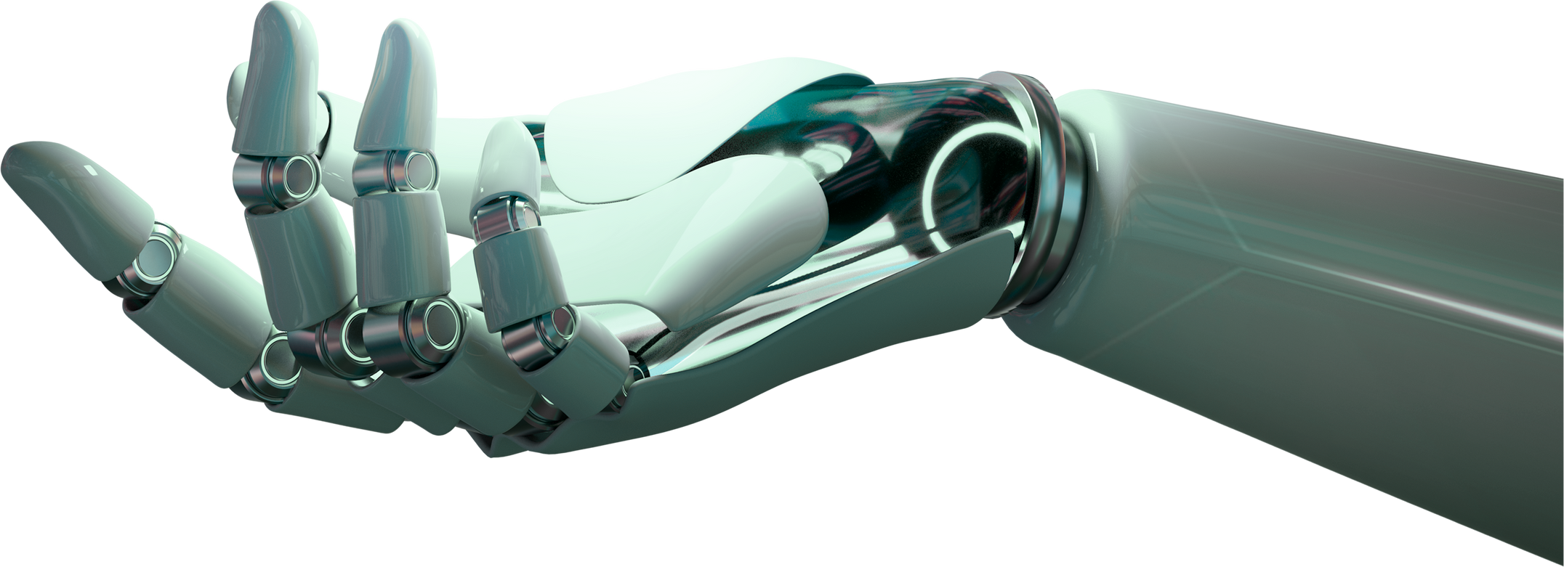
EduPredi stands for "Educational Prediction System." The name reflects the project's primary goal of predicting student performance using advanced machine learning techniques. By combining "Edu" (Education) with "Predi" (Prediction), the name explaine its purpose: to provide educators with predictive insights to support student success.
INTRODUCTION

Slide 3
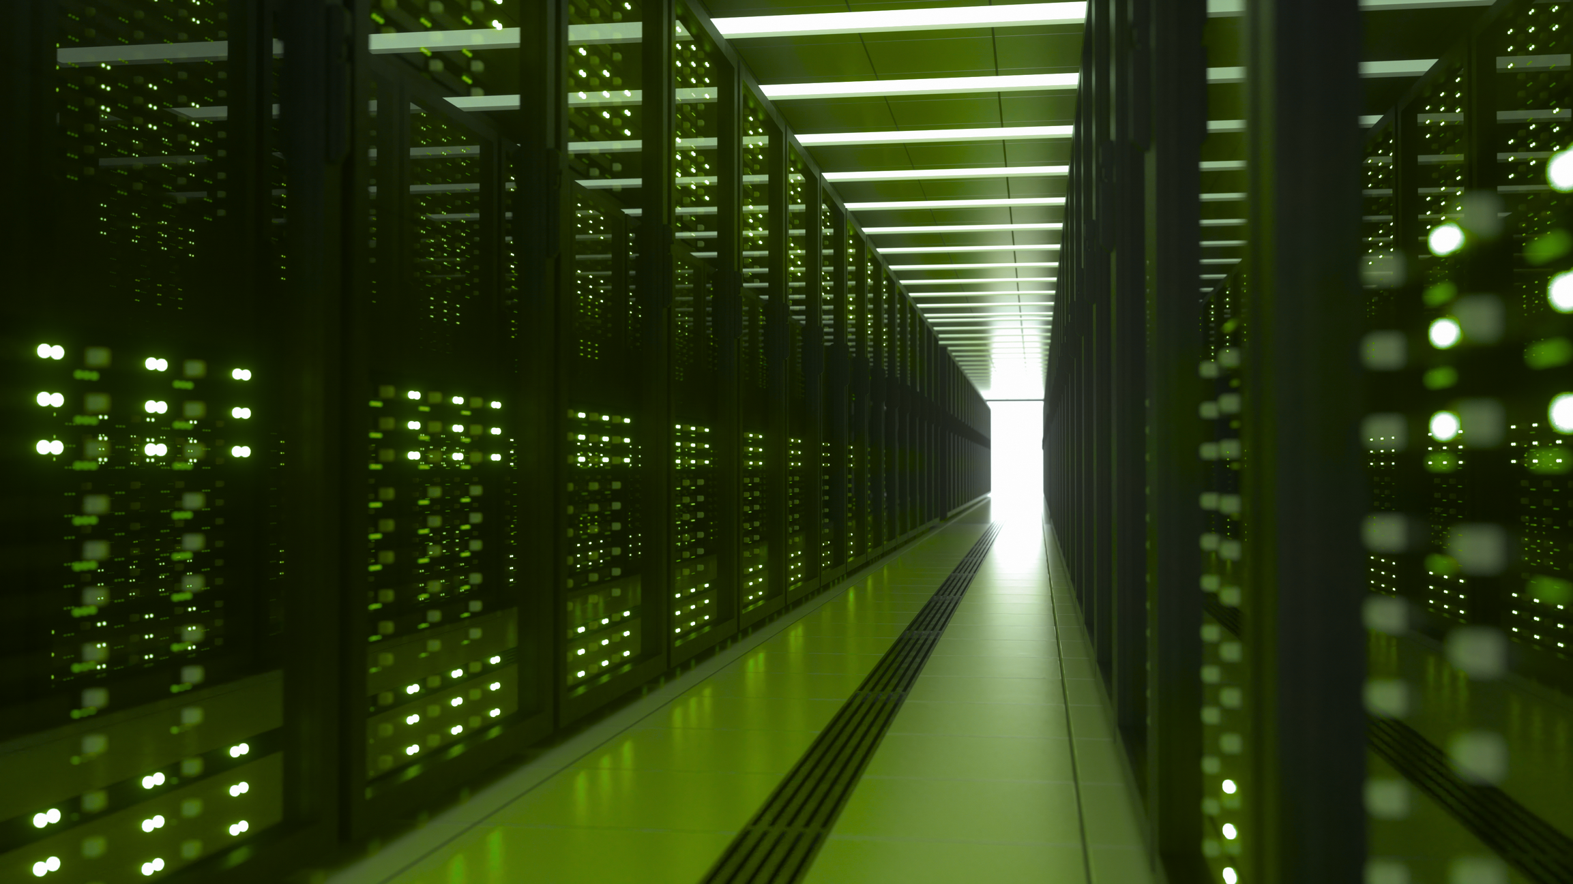
Objectives
Develop a web-based application for educational data processing.
Implement machine learning models to predict student outcomes based on historical data.
Provide a user-friendly interface for data upload and predictions.
Problem Statement
Educational institutions need a reliable, user-friendly system to predict student performance, helping educators tailor their teaching approaches to individual needs.

Slide 4
Key Features
Multiple Prediction Models: Decision Tree Id3, Decision Tree C4.5, And Linear Regression.
User-friendly Interface: Simplified For Use By Educators, Students, And Parents.
Flexible Data Handling: Users Can Upload Their Datasets For Predictions.
Methodology
Technologies Used: Django for web framework, Pandas and Scikit-Learn for data processing and machine learning.
Model Selection: Incorporating diverse algorithms to handle different data types and enhance prediction accuracy.

Slide 5

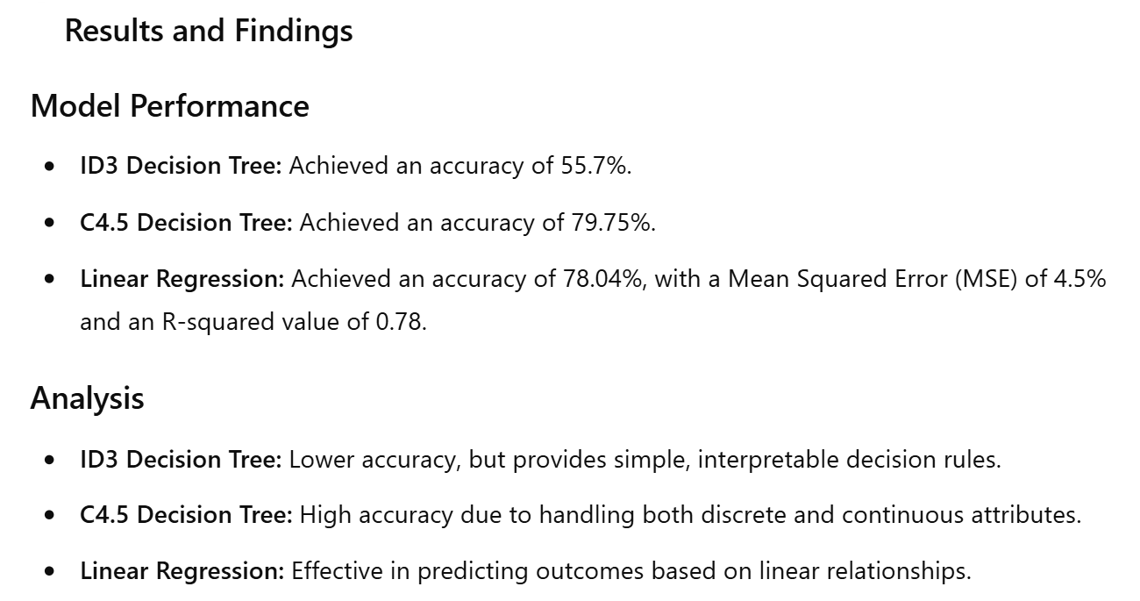

Slide 6
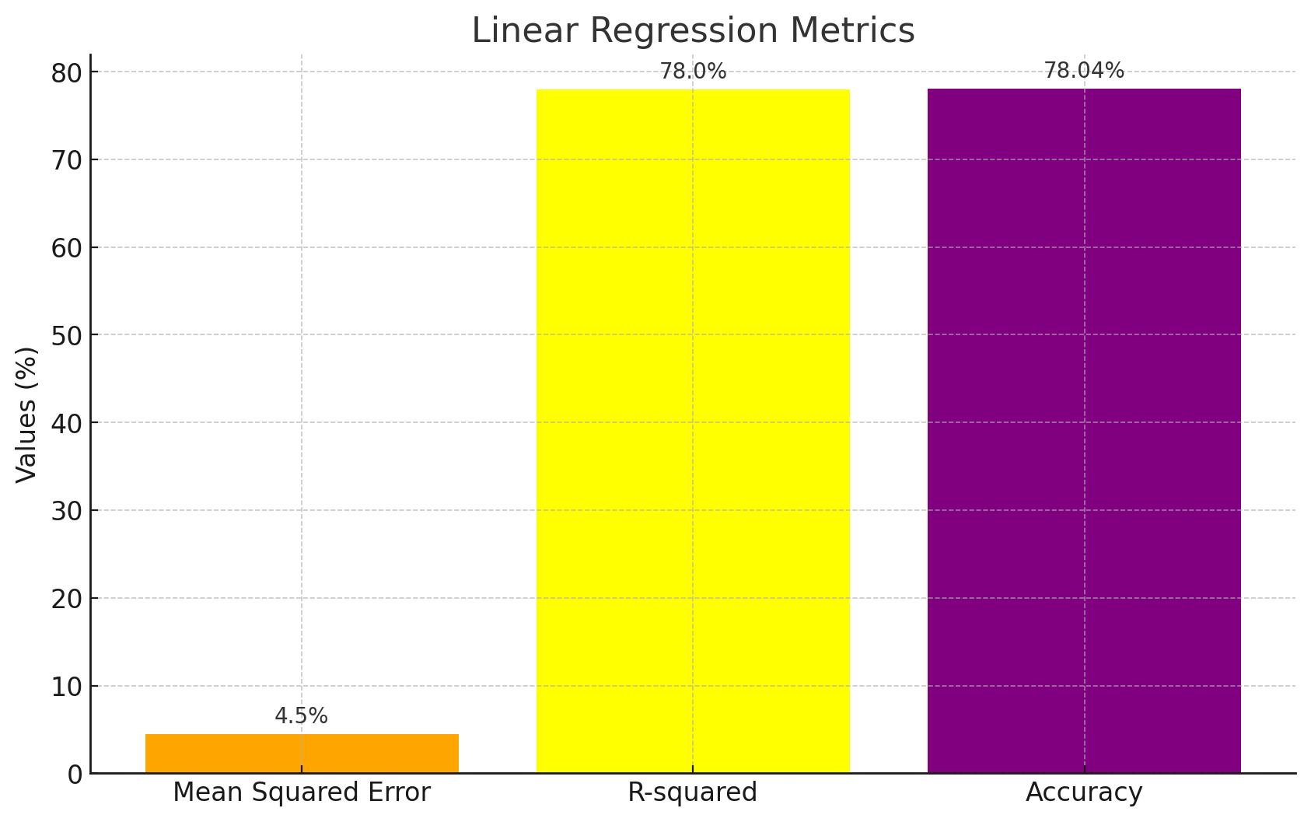

Slide 7
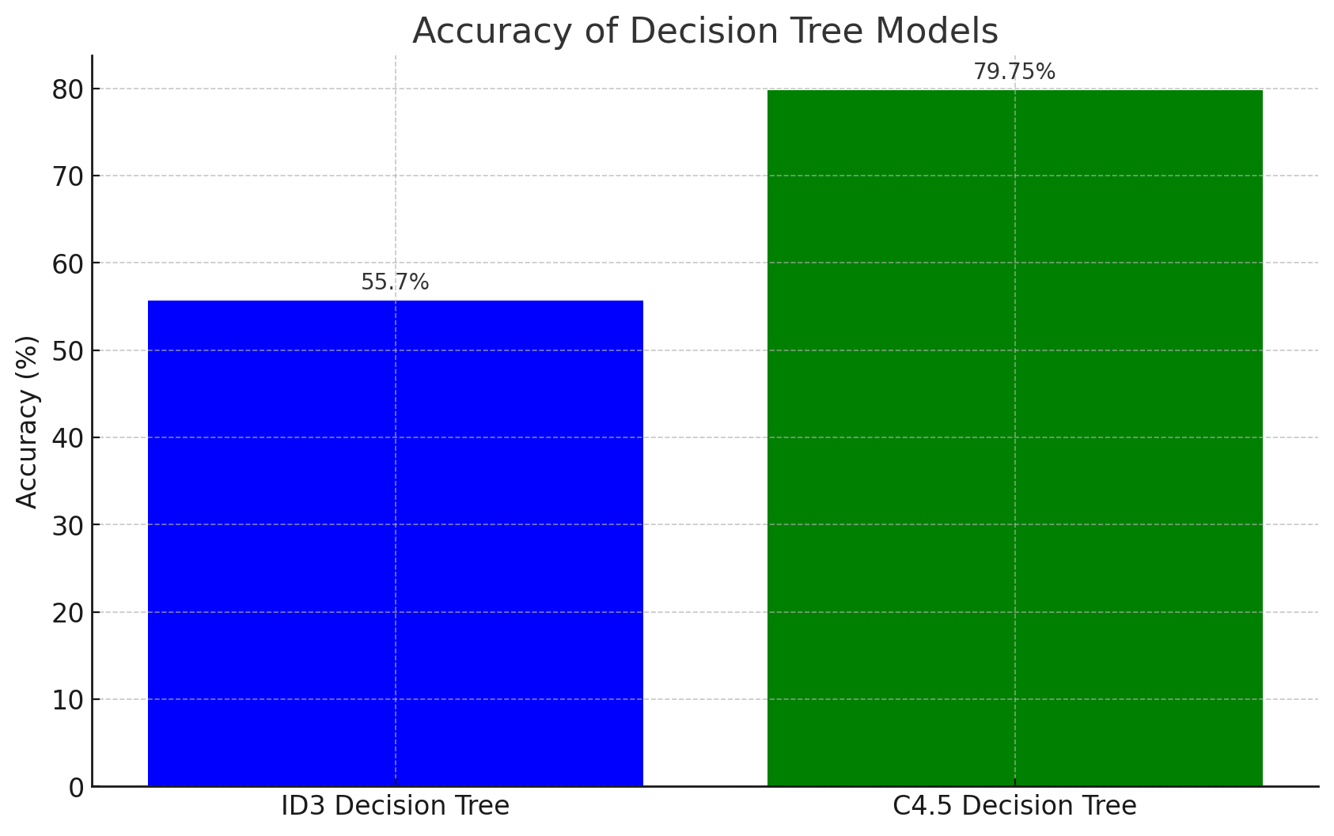

Slide 8
Educational Improvement: Early identification of at-risk students and tailored interventions.
Flexible Application: Suitable for various educational environments and data types.
Impact

Slide 9

Advanced Models: Integration of more sophisticated machine learning models such as neural networks.
Enhanced Data Metrics: Incorporating additional educational metrics and real-time data analysis.
Broader Data Sources: Expanding to include student engagement levels and socio-economic factors.
Future Directions

Slide 10

Challenges and Solutions
Challenges:
Data Quality and Diversity: Ensuring high-quality data and handling various data types (numerical, categorical).
Model Flexibility: Adapting predictive models to different educational datasets.
Usability: Creating a user-friendly interface for non-technical users.
Solutions:
Robust Data Preprocessing: Implemented feature scaling and encoding to improve data quality.
Multiple Algorithms: Integrated Decision Tree ID3, C4.5, and Linear Regression to handle diverse data types.
User-Centered Design: Developed an intuitive interface to ensure ease of use for educators and administrators.

Slide 11
EXPERIENCE THE EDUPREDI SYSTEM

Slide 12
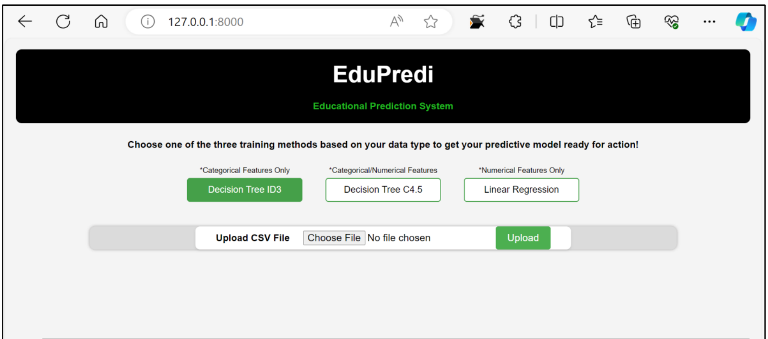

Slide 13
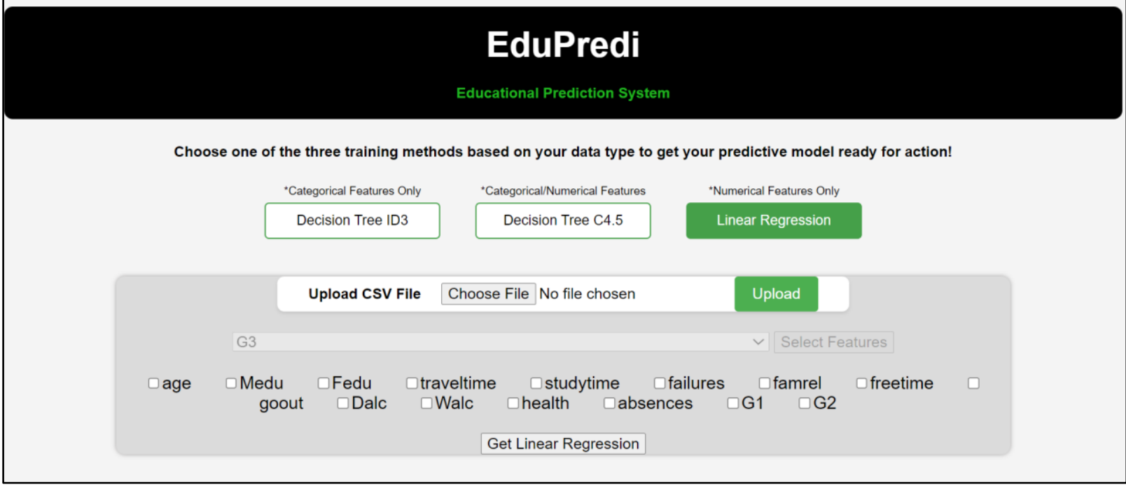

Slide 14
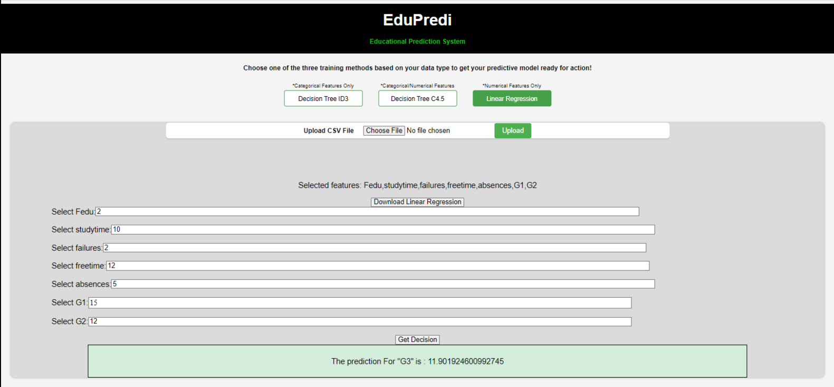

Slide 15
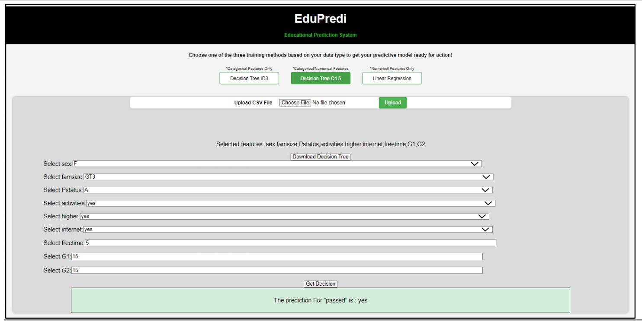

Slide 16
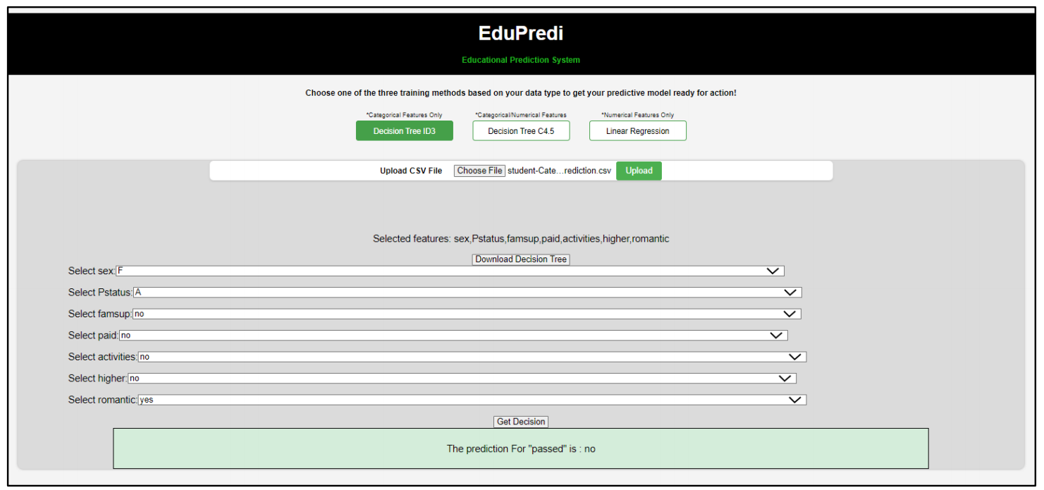

Slide 17


EduPredi showcases the benefits of predictive analytics in education, providing valuable insights into student performance with advanced machine learning models. Its user-friendly interface and flexible data handling make it a practical tool for enhancing educational outcomes.
Conclusion

Slide 18
Thank You

